Slide 1

Unplugged 29/5/18
Creating better board reports
David Woodnorth

Slide 2
Better board reporting
Feedback from directors
First up – “Remind me why I am reading this?”
Up front – give me context & the key information – don’t make me read pages to find these!
Make it engaging & easy, please!

Slide 3
Better board reporting
Tell me:
How material is this information?
Why it is important?
What is being done about it
Highlight trends
Help me to ask the right questions

Slide 4
Better board reporting
Feedback from ComplyWith community
Better presentation
Better trend analysis
Overview of relevant law changes
A heat map for non-compliances
& more...

Slide 5
Better board reporting
A new ComplyWith reporting module
A templated report (1 document!)
Front page overview infographics +
4 (max) pages of key information (mix of infographics & words) +
Required detail in appendices
Aim is for initial release by mid-August ‘18

Slide 6
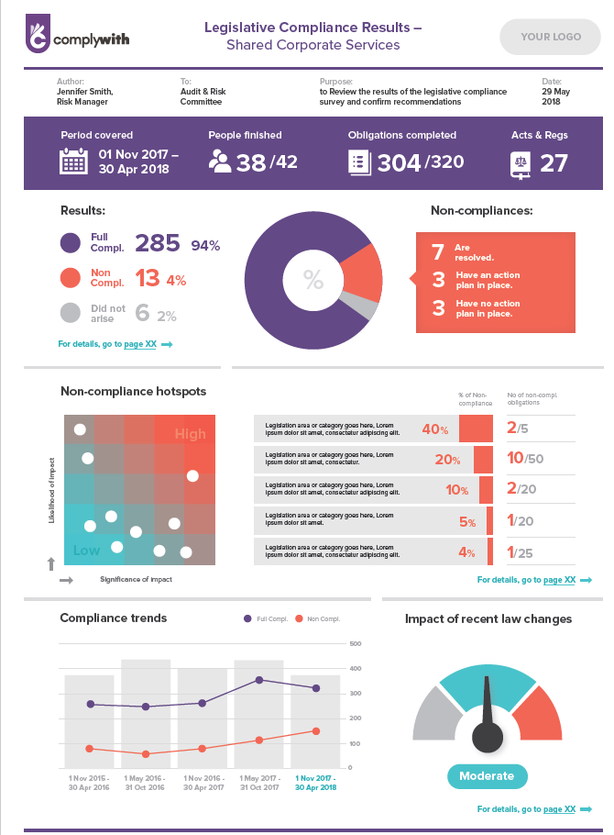
Better board reporting
New front
page –
engaging
useful
overview

Slide 7
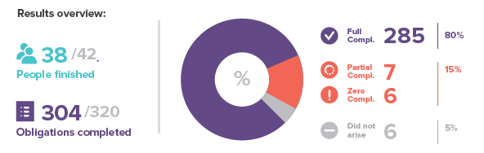
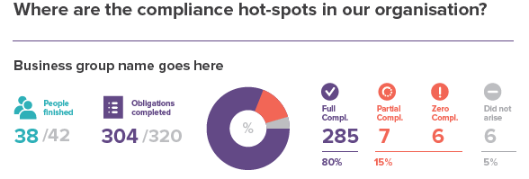
Better board reporting
Body of report - Overview of results
Can be segmented out into business groups

Slide 8
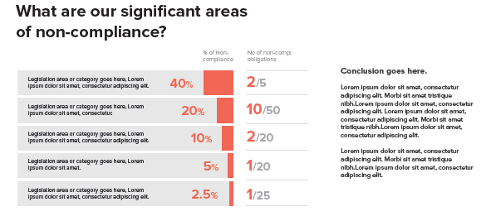
Better board reporting
Legal areas with the most non-compliances?
Highlight what
legislation (or
category) has
the most issues

Slide 9
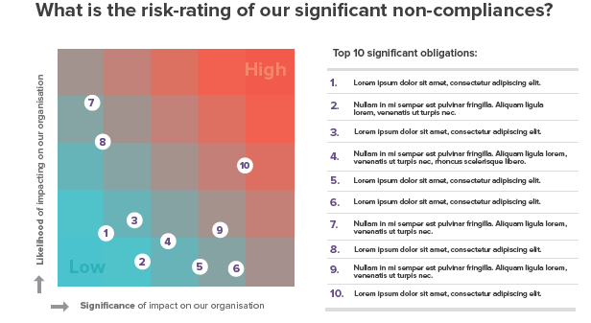
Better board reporting
Heat map the most significant issues
Identify
Assess
Present

Slide 10
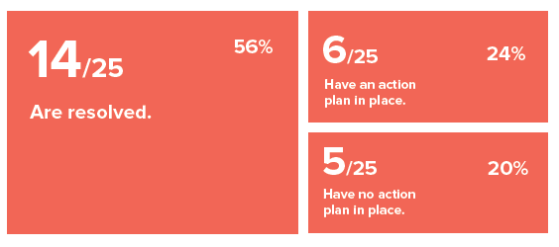
Better board reporting
Corrective actions – (more work to do here!)

Slide 11
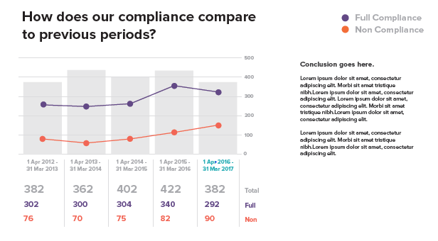
Better board reporting
Trend analysis

Slide 12
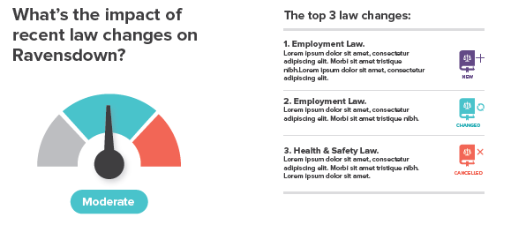
Better board reporting
Providing more information that is useful to directors & senior management

Slide 13
Thank you.

